Slide 1


INTERNET OF THINGS
OBJECT DETECTION SYSTEM FOR VISUALLY IMPAIRED USING ULTRASONIC SENSOR
AJAY (210701020)
AKSHAY (210701022)
ANTO ROSHAN (210701029)

Slide 2
INTRODUCTION
This project proposes the development of an object detection system tailored for visually impaired individuals to enhance their mobility and safety. The system utilizes an Arduino microcontroller, an ultrasonic sensor (HC-SR04), and a buzzer to detect obstacles in the user's path and provide auditory alerts when necessary. The ultrasonic sensor measures distances by emitting sound waves and The project outlines the components, functionality, implementation details, simulation using Tinkercad, and future improvements. With further refinement, the system has the potential to significantly improve the independence and quality of life for visually impaired individuals by assisting them in navigating their surroundings more confidently and safely.

Slide 3
HARDWARE COMPONENTS
Arduino Uno: This microcontroller serves as the brain of the system, orchestrating the interactions between the sensor and the buzzer.
Ultrasonic Sensor (HC-SR04): This sensor plays a crucial role in detecting objects by emitting sound waves and measuring the time taken for them to bounce back.
Buzzer: The buzzer provides auditory feedback to the user, alerting them when obstacles are detected.
Jumpers as required

Slide 4
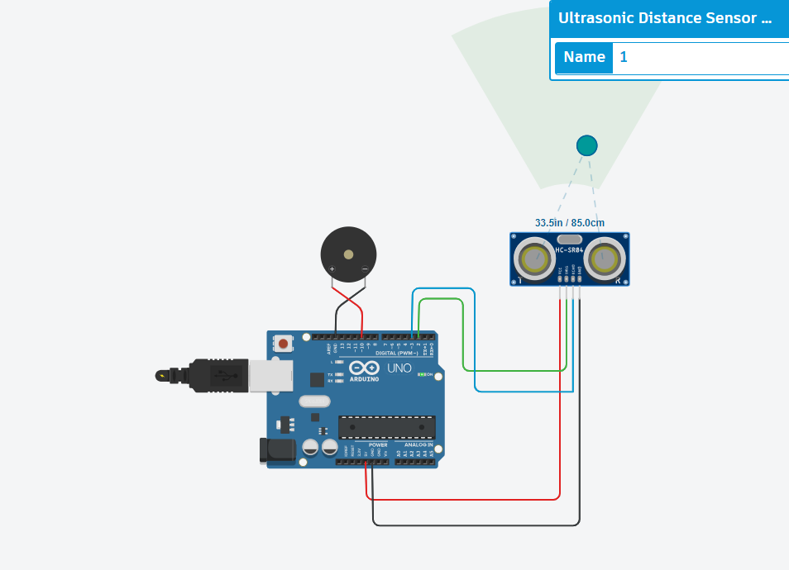
ARCHITECTURE

Slide 5
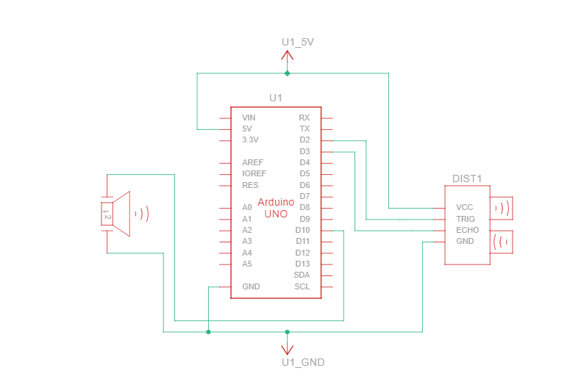
SYSTEM DESIGN

Slide 6
FUNCTIONALITY
The object detection system for visually impaired individuals operates by utilizing an Arduino microcontroller, an ultrasonic sensor, and a buzzer to enhance mobility and safety. Initially, the system initializes the necessary components and pins for the sensor and buzzer. The ultrasonic sensor emits high-frequency sound waves and measures the time it takes for them to bounce back after encountering obstacles, allowing the system to calculate the distance to nearby objects. If an obstacle is detected within a predefined range, typically set at 10 cm or less, the buzzer is activated to provide auditory feedback to the user. This alerts them to the presence of obstacles in their path, enabling them to navigate their surroundings more confidently and safely.

Slide 7
IMPLEMENTATION AND SIMULATION
The object detection system for visually impaired individuals is simulated and implemented using Arduino and Tinkercad. In the simulation phase, the system's functionality is tested virtually, ensuring that it operates as intended in a controlled environment. Tinkercad provides a platform for designing and simulating the circuitry, allowing for testing and debugging without the need for physical components. Once the simulation is successful, the system is implemented using physical components, including an Arduino microcontroller, an ultrasonic sensor (HC-SR04), and a buzzer. The Arduino code initializes the components and defines the logic for distance measurement and obstacle detection. During implementation, the circuit is assembled, and the code is uploaded to the Arduino board, enabling real-time operation of the object detection system. This iterative process of simulation and implementation ensures the reliability and effectiveness of the system in aiding visually impaired individuals in navigating their surroundings safely.

Slide 8
Thank You

